Slide 1
Points to be covered
Unit 2 :--
Inheritance
  Types of Inheritance (Single, Multilevel, Hierarchical)
  Constructor in inheritance (super and this keyword)
  Super class & subclass
  Abstract method and classes
  Method overriding
  final keyword
  super keyword
  Implementing interfaces
  User defined interfaces
Packages & Access Specifier
  Importing classes
  User defined packages
  Modifiers & Access control (Default, public, private, protected, private protected)
Understanding commonly used classes of java.lang package.
  Object class & String class
  Wrapper classes

Slide 2
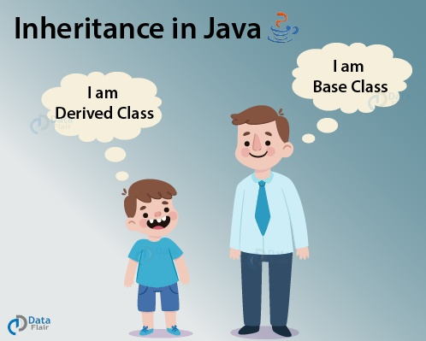
Inheritance
Unit 2

Slide 3
Introduction to Inheritance
Mechanism in Java by which one class is allowed to inherit the features(fields and methods) of another class.
You can create new classes that are built upon existing classes.
When you inherit from an existing class, you can reuse methods and attributes of parent class, and you can add new methods and attributes also.
extends is the keyword used to inherit the properties of a class.
Mechanism in which one object acquires all the properties and behaviors of parent object.
Inheritance represents the parent-child relationship.

Slide 4
Use of Inheritance
  For Method Overriding - runtime polymorphism
  For Code Reusability.
When a class extends another class it inherits all non-private members including attributes and methods.
Here parent class is also known as Super class and child class is known as Sub class.

Slide 5


Example & Syntax
Class A
Super Class
Example:
class A
{
//methods and attributes
}
class B extends A
{
//methods and attributes
}
extends
Class B
Sub Class
Syntax:
class Subclass-name extends Superclass-name
{
//methods and fields
}

Slide 6
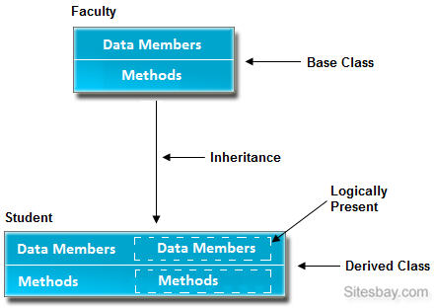
Inheritance

Slide 7
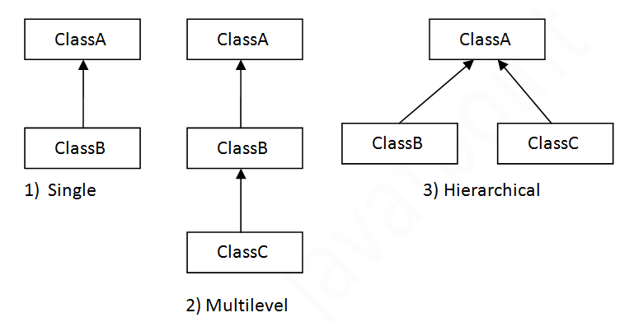
Types of Inheritance
There can be three types of inheritance in Java:
  Single
  Multilevel
  Hierarchical.
In Java programming, multiple and hybrid inheritance is not supported through class.

Slide 8
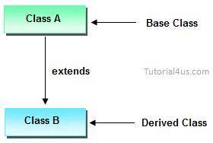
Single Inheritance
class University
{ void UniName()
{
System.out.println(“Atmiya University");
}
}
class Department extends University
{ void DeptName()
{
System.out.println(“C.S. & I.T.");
}
}
class Demo
{
public static void main(String args[])
{
Department obj = new Department ();
obj.UniName(); //calling superclass
obj.DeptName(); //calling local method
}
}

Slide 9
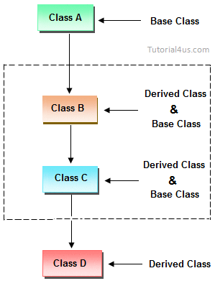
Multilevel Inheritance

Slide 10
Multilevel Inheritance
class X
{
public void methodX()
{
System.out.println("Class X method");
}
}
class Y extends X
{
public void methodY()
{
System.out.println("class Y method");
}
}
class Z extends Y
{
public void methodZ()
{
System.out.println("class Z method");
}
}
class MultiDemo
{
public static void main(String args[])
{
Z obj = new Z();
obj.methodX();
obj.methodY();
obj.methodZ();
}
}

Slide 11
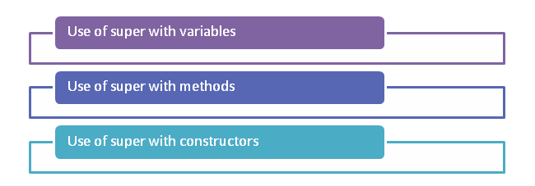
super keyword
To call methods of the superclass that is overridden in the subclass.
To access attributes (fields) of the superclass if both superclass and subclass have attributes with the same name.
To explicitly call superclass no-arg (default) or parameterized constructor from the subclass constructor.

Slide 12
Use of super keyword
class A
{
int a = 10;
}
class B extends A
{
int a =20;
public void display()
{
System.out.println(“value:”+a);
}
}
class Demo
{
public static void main(String args[])
{
B obj = new B();
obj.display(); //prints value of local a variable
}
}

Slide 13
Use of super keyword
class A
{
int a = 10;
}
class B extends A
{
int a =20;
public void display()
{
System.out.println(“value:”+a);
System.out.println(“value:”+super.a);
}
}
class Demo
{ public static void main(String args[])
{
B obj = new B();
obj.display();
}
}

Slide 14
super keyword with method
class A
{
void show()
{
System.out.println("From class A...");
}
}
class B extends A
{
void show()
{
super.show();
System.out.println("From class B...");
}
}
class SuperMethod
{
public static void main(String args[])
{
B obj = new B();
obj.show();
}
}

Slide 15
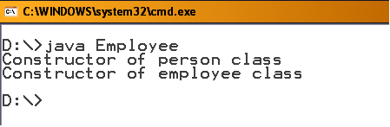
Constructor in Inheritance
class Person
{
Person()
{
System.out.println("Constructor of person class");
}
}
class Employee extends Person
{
Employee()
{
System.out.println("Constructor of employee class");
}
}
class ConDemo
{
public static void main(String args[])
{
Employee e1 = new Employee();
}
}
Note that the super class person constructor executes before the subclass Employee

Slide 16
Use of Super keyword in inheritance
class Person
{
String fname, lname;
Person(String fname, String lname)
{
this.fname = fname;
this.lname= lname;
}
}
class Student extends Person
{
int rollno;
String stream;
int sem;
Student(String fname, String lname,int rollno, String stream, int sem )
{
super(fname,lname);
this.rollno=rollno;
this.stream= stream;
this.sem= sem;
}
void display()
{
System.out.println(“ Name: "+fname+" "+lname);
System.out.println(“ Roll no: "+rollno);
System.out.println(“ Division: " +stream+" Sem "+sem);
}
}
class StudDemo
{
public static void main(String args[])
{
Student s1 = new Student(“Gopi",”Rangani",30,“M.B.B.S.",2);
s1.display();
}
}

Slide 17
Method Overriding
If subclass (child class) has the same method as declared in the parent class, it is known as method overriding in Java.
Same name and Same Signature but in different class having parent child relationship.
Method overriding is used to achieve runtime(dynamic) polymorphism.

Slide 18
Example…
class Bank
{
int getInterest()
{
return 0;
}
}
class SBI extends Bank
{
int getInterest()
{
return 8;
}
}
class ICICI extends Bank
{
int getInterest()
{
return 7;
}
}
class AXIS extends Bank
{
int getInterest()
{
return 9;
}
}
class Test_Bank
{
public static void main(String args[])
{
SBI s=new SBI();
ICICI i=new ICICI();
AXIS a=new AXIS();
System.out.println("SBI Interest Rate:"+s.getInterest());
System.out.println("ICICI Interest Rate :"+i.getInterest());
System.out.println("AXIS Interest Rate:"+a.getInterest());
}
}

Slide 19
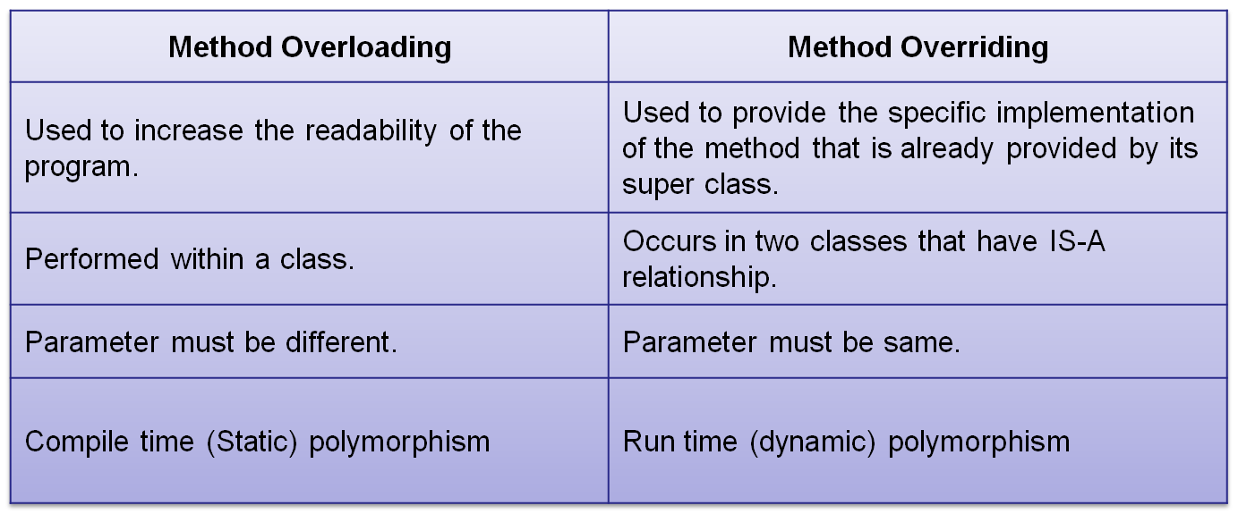
Method Overloading Vs. Method Overriding

Slide 20
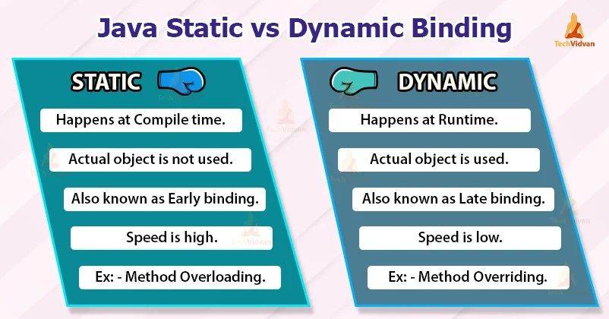

Slide 21
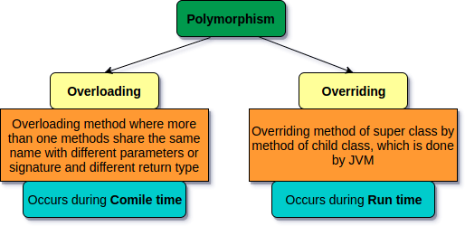

Slide 22
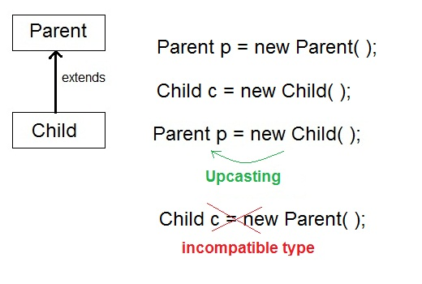
Dynamic Method Dispatch
Dynamic Binding
Dynamic method dispatch is the mechanism by you can achieve Run-time Polymorphism
Object of child class is handled by reference of parent class– Dynamic method dispatch

Slide 23
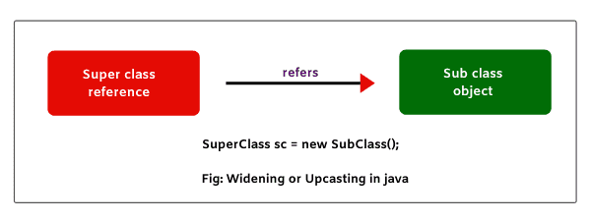
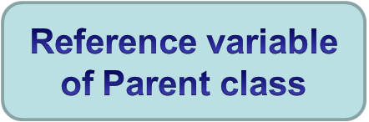

Dynamic Method Dispatch : Up casting
When reference variable of Parent class refers to the object of Child class, it is known as upcasting.
  For example:
  class A
  {
  }
  class B extends A
  {
  }
  A a=new B();//upcasting

Slide 24
Dynamic Method Dispatch : Upcasting
class Shape
{
void draw()
{
System.out.println(“No shape to draw");
}
}
class Rectangle extends Shape
{
void draw()
{
System.out.println("drawing rectangle");
}
}
class Circle extends Shape
{
void draw()
{
System.out.println("drawing circle");
}
}
class DynamicDis
{
public static void main(String args[])
{
Shape s;
s=new Circle();
s.draw();
s= new Rectangle();
s.draw();
}
}

Slide 25
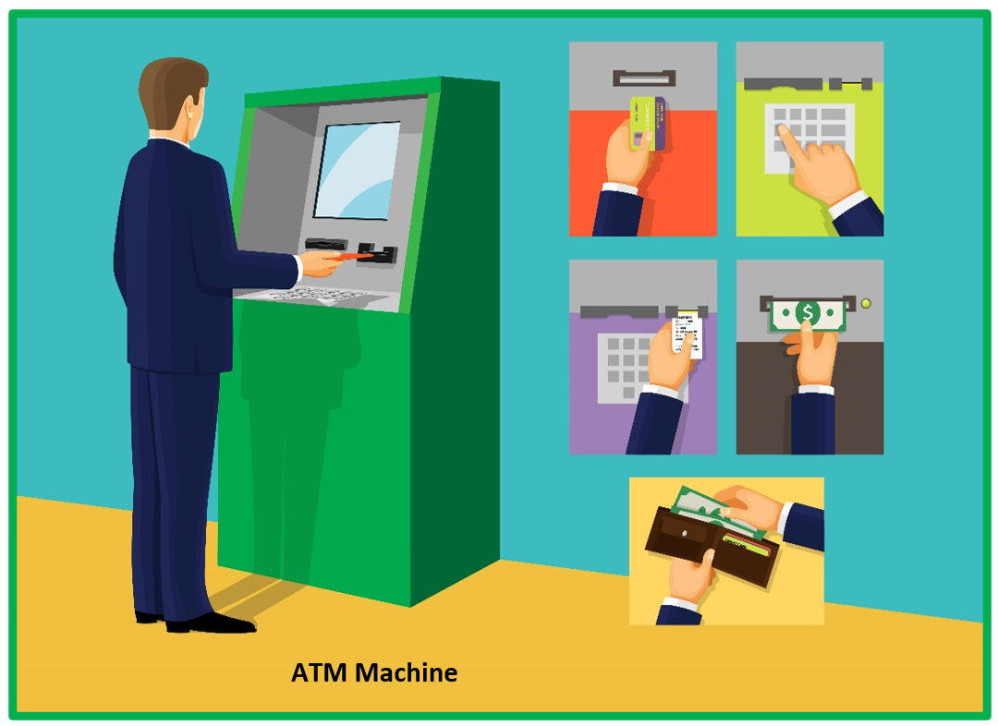
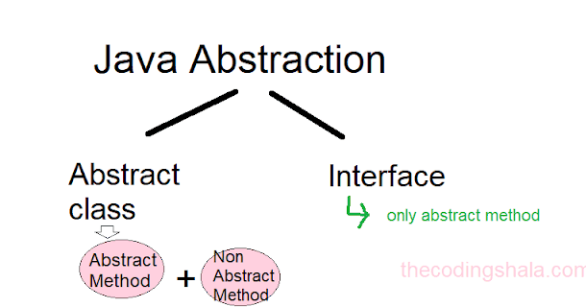

Slide 26
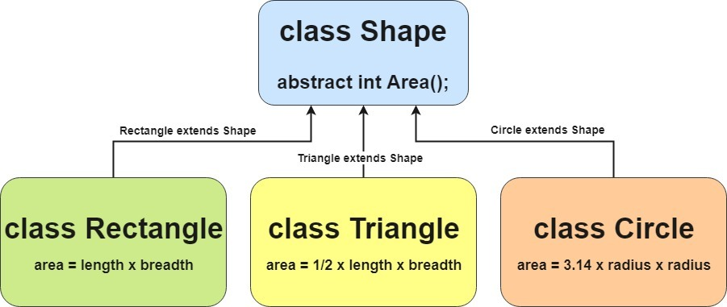
Abstract class and Abstract Method

Slide 27
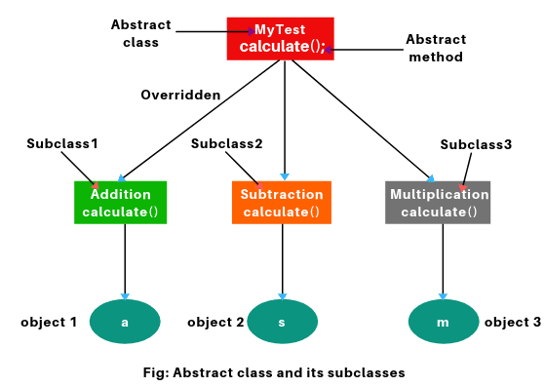

Slide 28
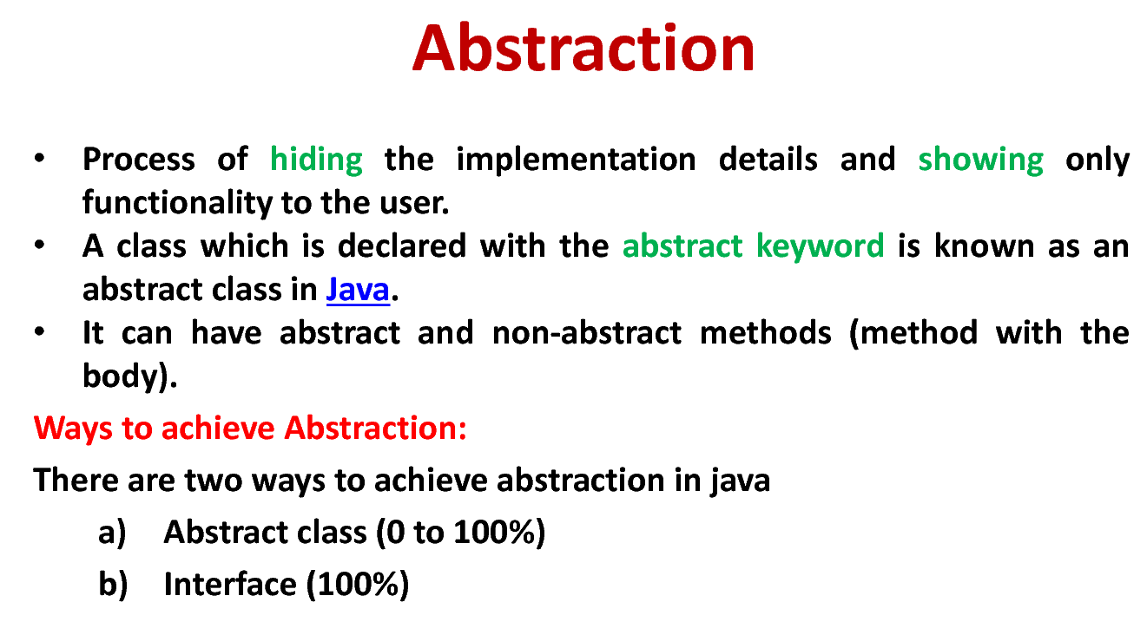

Slide 29
Abstract Methods and Classes
An abstract class is a class that is declared abstract—it may or may not include abstract methods.
Object of an Abstract classes cannot be created, but it can be sub classed.
An abstract method is a method that is declared without an implementation
abstract Returntype methodName(argu list);
If any class includes abstract methods, the class itself must be declared as abstract.
If you are extending any abstract class having abstract method, you must either provide the implementation of the method or make this sub class also abstract.

Slide 30
Example of abstract keyword
abstract class Shape
{
abstract void draw();
}
class Rectangle extends Shape
{
void draw()
{
System.out.println("drawing rectangle");
}
}
class Circle extends Shape
{
void draw()
{
System.out.println("drawing circle");
}
}
class Test_Abstract
{
public static void main(String args[])
{
Shape s;
s=new Circle();
s.draw();
s= new Rectangle();
s.draw();
}
}

Slide 31
An abstract class must have atleast one abstract method….
abstract class Bike
{
Bike()
{
System.out.println(“Bike is created");
}
abstract void run();
void changeGear()
{
System.out.println("gear changed");
}
}
class Honda extends Bike
{
void run()
{
System.out.println("running safely..");
}
}
class Demo_Abstraction
{
public static void main(String args[])
{
Bike obj = new Honda();
obj.run();
obj.changeGear();
}
}
Output:
Bike is created
running safely..
gear changed

Slide 32
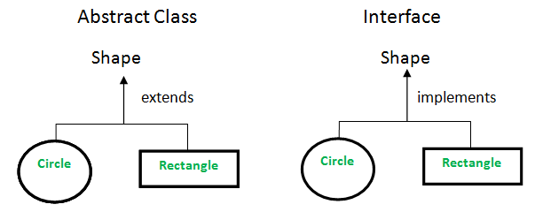

Slide 33
Introduction to Interface
An interface in Java is a blueprint of a class.
It has static constants and abstract methods only.
There can be only abstract methods in the Java interface not method body.
It is used to achieve fully abstraction and multiple inheritance in Java.
Java Interface also represents IS-A relationship.
It cannot be instantiated just like abstract class.

Slide 34
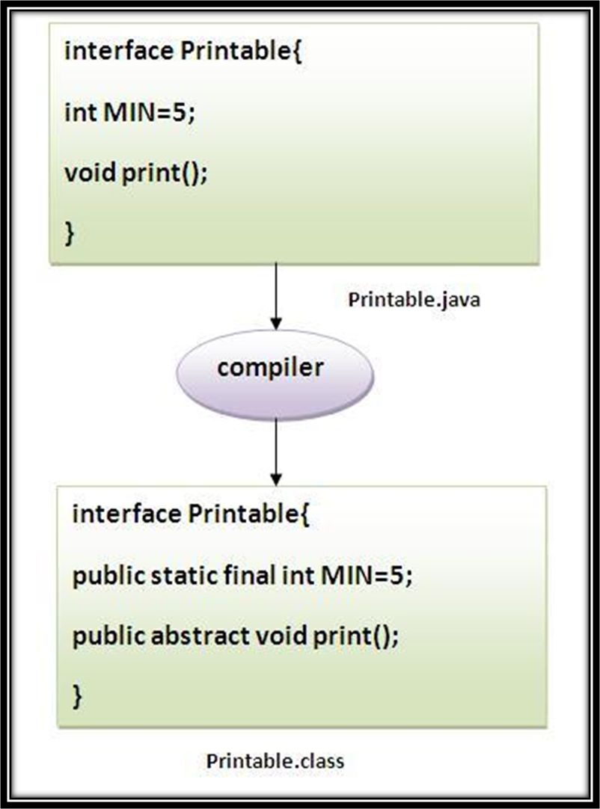
Interface…
Note:
The java compiler adds public and abstract keywords before the interface method
public, static and final keywords before data members

Slide 35
Interface…
You cannot instantiate an interface. (Can’t create an object)
An interface does not contain any constructors.
All of the methods in an interface are abstract.
An interface cannot contain instance fields. The only fields that can appear in an interface must be declared both static and final.
An interface is not extended by a class; it is implemented by a class.
An interface can extend multiple interfaces.

Slide 36
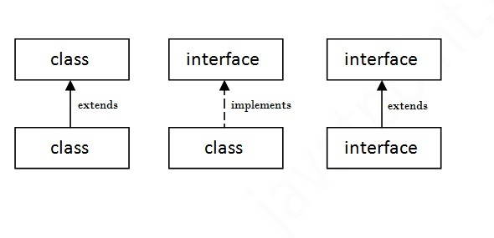
Class & Interface…
A class extends another class
An interface extends another interface
class implements an interface.

Slide 37
Declaring Interfaces
The interface keyword is used to declare an interface.
Syntax:
interface NameOfInterface
{
//Any number of final, static fields
//Any number of abstract method declarations
}

Slide 38
Example
interface printable
{
void print();
}
class Test_Interface implements printable
{
public void print()
{
System.out.println("Hello");
}
}
class IntDemo
{
public static void main(String args[])
{
Test_Interface obj = new Test_Interface();
obj.print();
}
}

Slide 39
Example…
interface Shape
{
String LABLE="Shape";
void draw();
double getArea();
}
class Circle implements Shape
{
double radius;
Circle(double r)
{
this.radius = r;
}
public void draw()
{
System.out.println("Drawing Circle");
}
public double getArea()
{
return 3.14*r*r;
}
}
class ShapeTest
{
public static void main(String[] args)
{
Shape s = new Circle(10);
s.draw();
System.out.println("Area=“ + s.getArea());
}
}
Output:
Drawing Circle
Area=314.1592653589793

Slide 40
Extending Interfaces:
interface Printable
{
void print();
}
interface Showable extends Printable
{
void show();
}
class Test implements Showable
{
public void print()
{
System.out.println("Hello");
}
public void show()
{
System.out.println("Welcome");
}
}
class InterDemo
{
public static void main(String args[])
{ Test obj = new Test();
obj.print();
obj.show();
}
}

Slide 41
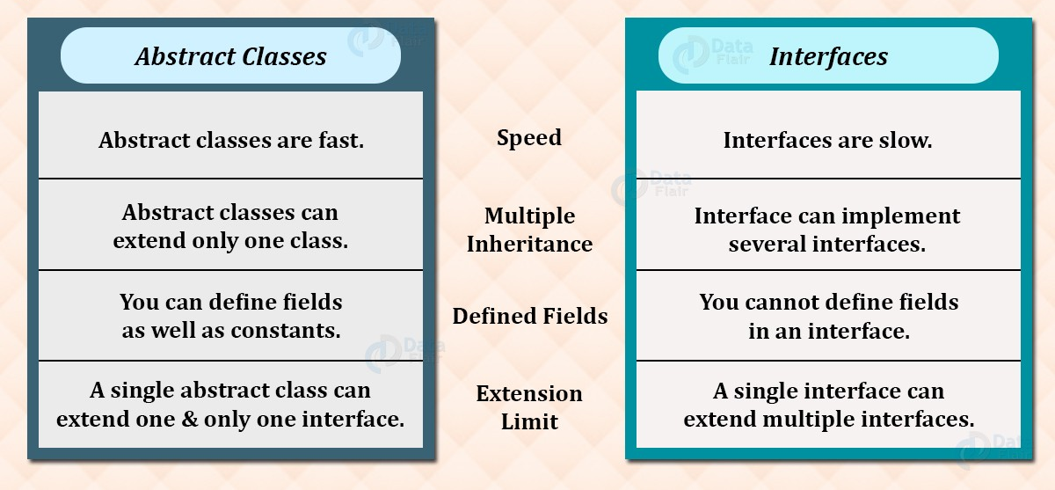
Abstract class v/s Interface

Slide 42
Final class, variables and methods
Java classes declared as final cannot be extended. Restricting inheritance!
A java variable can be declared using the keyword final. Then the final variable can be assigned only once. –Constant variable
Methods declared as final cannot be overridden.

Slide 43
final keyword
The final keyword in Java is used to restrict the user.
final can be:
  variable
  method
  Class
Java final variable: if you make variable as final you can not reinitialized it. Which used to declare a constant variable.
Java final method: If you make any method as final, you cannot override it.
Java final class :If you make any class as final, you cannot extend it.

Slide 44
Example of final method
class Bike
{
final void run()
{
System.out.println("running");
}
}
class Honda extends Bike
{
void run()
{
System.out.println("running safely with 100kmph");
}
}
class FinalDemo
{
public static void main(String args[])
{
Honda honda= new Honda();
honda.run();
}
}
Output:
Compile time error

Slide 45
Example of final class
final class Bike
{
void run()
{
System.out.println("running ”);
}
}
class Honda extends Bike
{
void run()
{
System.out.println("running safely ");
}
}
class FinalDemo
{
public static void main(String args[])
{
Honda1 honda= new Honda();
honda.run();
}
}
Output:
Compile time error

Slide 46
The finalize( ) Method
Sometimes an object will need to perform some action when it is destroyed.
For example, if an object is holding some non-Java resource such as a file, then you might want to make sure these resources are freed before an object is destroyed.
To handle such situations, Java provides a mechanism called finalization.
By using finalization, you can define specific actions that will occur when an object is just about to be reclaimed by the garbage collector.
finalize( ) is only called just prior to garbage collection.
The finalize( ) method has this general form:
  protected void finalize( )
  {
    // finalization code here
  }

